Slide 1

ICT Cloud‐based Platform and Mobility Services
Available, Universal and Safe for all Users
Ignacio (Iñaki) Olabarrieta
Bilbao 15-10-15
1st MOVESMART WORKSHOP
October 2015

Slide 2













PROJECT
Coordinator’s Contact
Susana Palomares(ATOS) susana.palomares@atos.net
Sergio Campos (TECNALIA) sergio.campos@tecnalia.com
@FP7MoveUs
FP7 MoveUs Project
Members:
2

Slide 3



GOALS AND OBJECTIVES
MoveUs aims to radically change the European users’ mobility habits by offering intelligent and personalized travel information services, helping people to decide the best transport choice and providing meaningful feedback on the energy efficiency savings obtained as a result.
To integrate mobility data from heterogeneous sources and deliver it in a coherent and useful way
To provide green, multimodal, personalized, sustainable, safe and private, reliable and extensible services
Provide business cases and incentives recommendations for smart mobility services in urban environments.
Main Objectives:
3

Slide 4

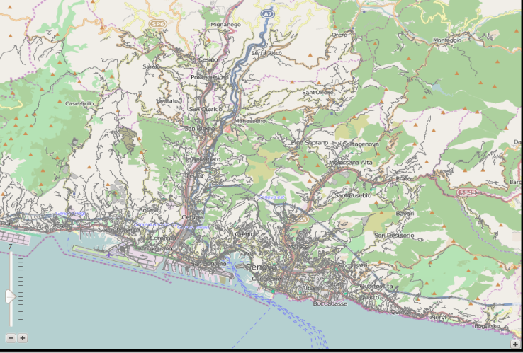
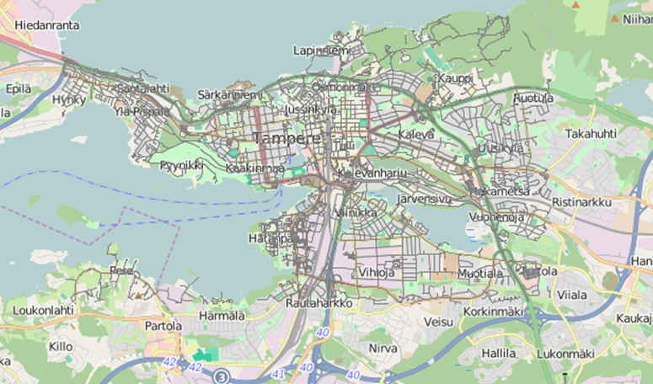
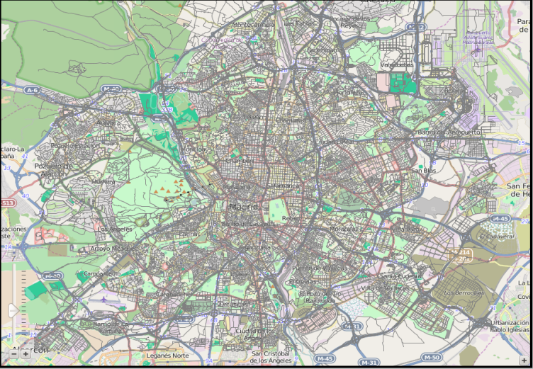
Data Model:
Use Cases:
Tampere
eMotion
In-Time
Co-Cities
Genoa
Energy Consumption/Carbon Footprint.
It includes: Key-Performance Indicators
(KPIs), energy labels and parameters
affecting energy consumption .
Madrid
4

Slide 5
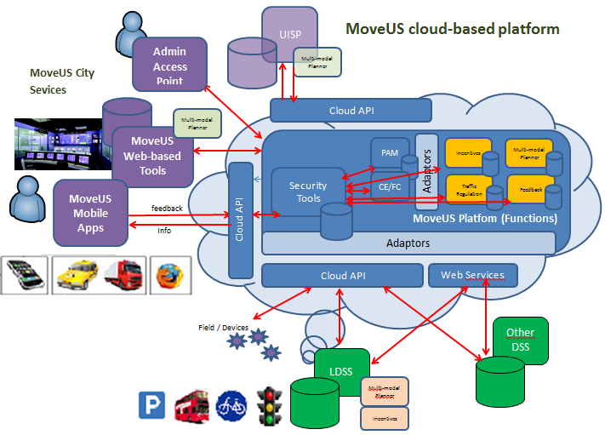
OPERATIONAL SCENARIO
5

Slide 6
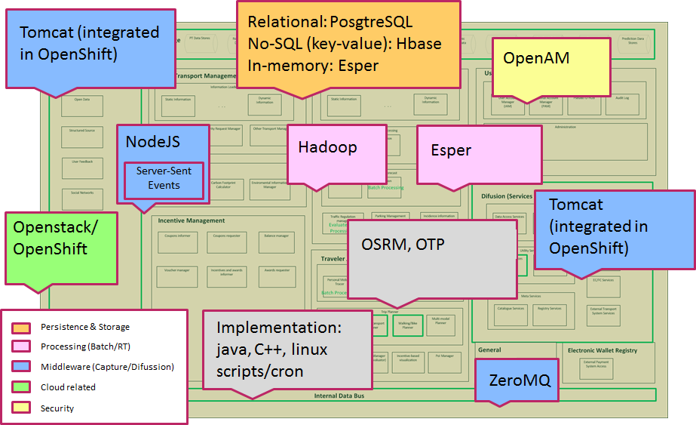
OPEN SOURCE BASED
www.moveus-project.eu

Slide 7
SERVICES
Trip Planning and infomobility
Location-based information services on traffic and mobility
Multimodal Trip Planning
Crowd Data Management
Crowd-sourced data collection and feedback options
Energy Consumption Status and Suggestions
Assess the energy efficiency and/or CO2 cost of a journey.
Incentive management
Management of incentives, awards, coupons, advertisement, vouchers and providers of these elements.
Smart Crossing for pedestrians
Detects of pedestrian crossing and extends the green time until it has crossed safely.
Priority for Public Transport vehicles
Prioritizes to specific vehicles (public buses) on intersections controlled by traffic lights from the Urban Traffic Control System.
User Management
Manages the user’s mobility personal profile enabling personalized and customized mobility information service.
Positioning
A geocoding service
7

Slide 8
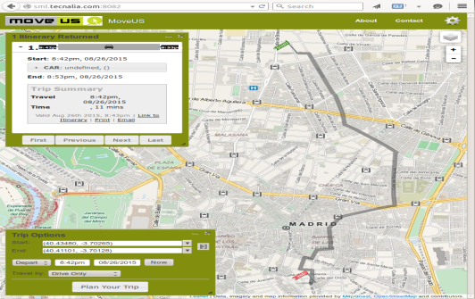
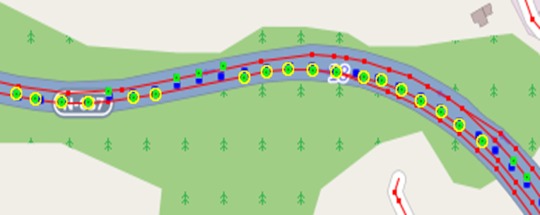
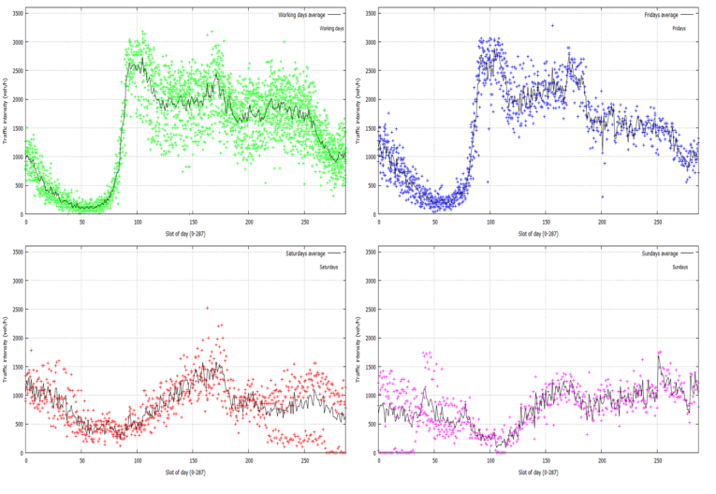
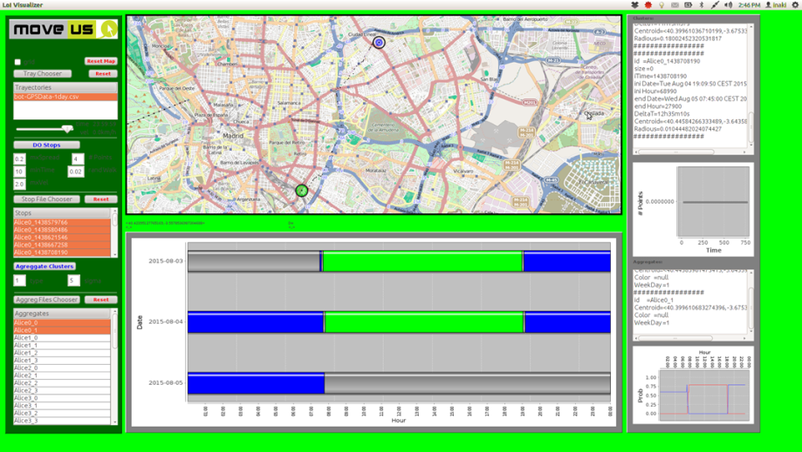
ALGORITHMS
Multi-Modal Planning
Data Sources Aggregation
Traffic State Prediction
Personal Mobility Patterns & Trip Prediction
Energy Efficiency Calculation

